Slide 1



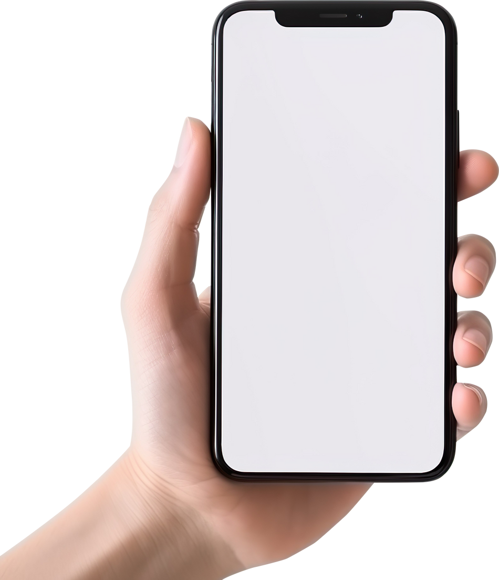
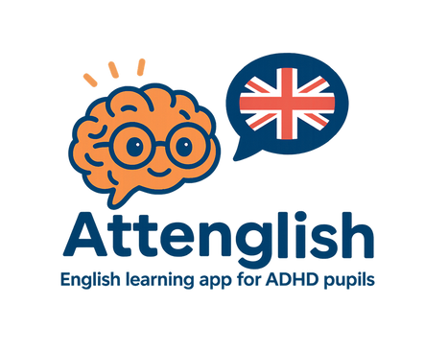
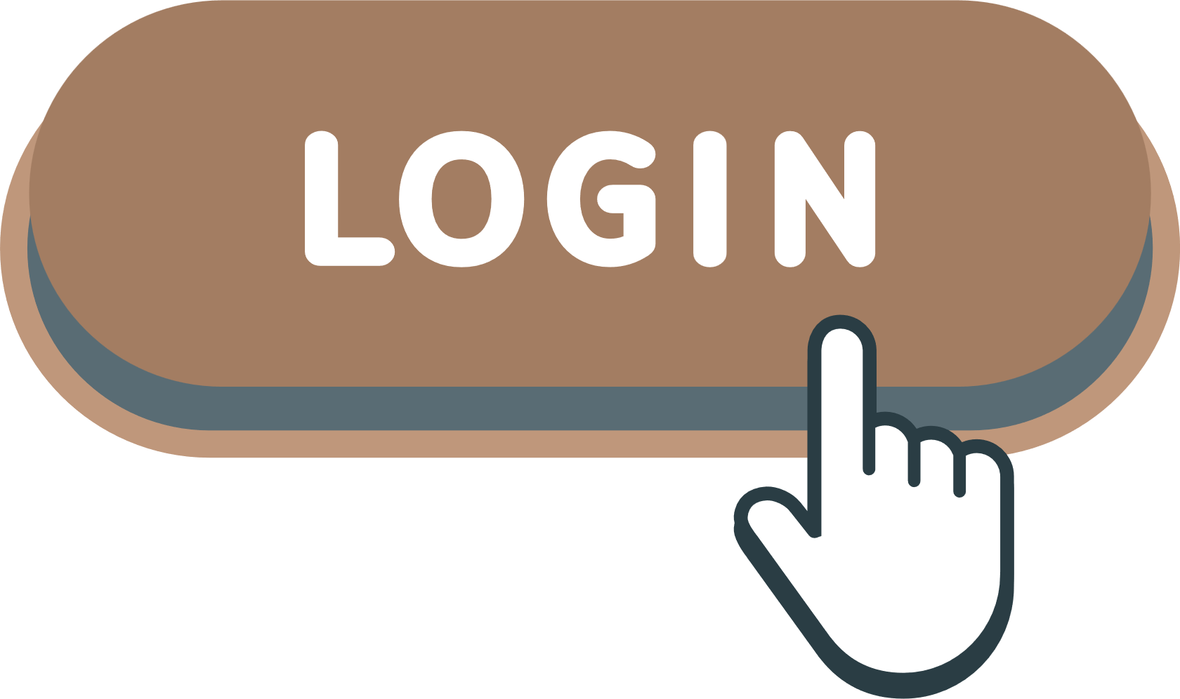
Attenglish: English Learning App for ADHD Pupils
Capstone Project 25-2-D-16
Presented by Kfir Amoyal & Omri Heit
Advisor: Dr. Natali Levi
Notes:
Hello everyone and welcome to our presentation of Attenglish, an English Learning App for ADHD Pupils. My name is Omri and joining me is Kfir. First we would like to thank our Advisor, Natali, and our stakeholder, Keren.

Slide 2

Background
Attention-Deficit/Hyperactivity Disorder (ADHD) is increasingly prevalent in classrooms worldwide, posing significant challenges to both students and educators.
Learning English as a second or foreign language can be complicated for most lower-education pupils, but the process becomes particularly challenging for K-12 pupils diagnosed with ADHD or other learning difficulties.
Notes:
“So Why ADHD & English learning?"
Attention-Deficit Hyperactivity Disorder, or ADHD for short, affects about 5–7% of students worldwide (me included), and it deeply impacts listening, memory, and retaining focus & attention.
Now imagine learning a foreign language—which is already difficult—when your brain struggles to focus or retain verbal information.
From talking with teachers, especially our stakeholder Keren, a middle-school English teacher for students with learning difficulties, we heard the same thing again and again: traditional teaching methods just don’t work well for these students.
That’s the gap we wanted to address with Attenglish.

Slide 3

The Need
While many existing language-learning platforms, such as Duolingo, Memrise etc., offer gamified lessons and interactive modules, few specifically address the unique challenges faced by ADHD students. From interviewing our stakeholder, Keren, her main “pain-points” are:
Multi‑level customization takes time.
Needs micro‑lessons & movement breaks.
Lack of AI powered lessons and exercises.
There are no real‑time “red buzzer” alerts & dashboards.
Wants
Needs
Notes:
Think about the slick language apps we all know - Duolingo, Memrise. Great for the average pupil, but they assume steady attention spans. Our students and their teachers don’t have that luxury.
Keren for example spends hours slicing every text into different reading levels. This customization burden is her #1 pain-point.
Second, she’s learned that tiny, bite-sized ‘micro-lessons’ with built-in movement breaks keep an ADHD class on track. Today she has to hack those breaks in manually.
Third, none of her current tools create adaptive content for her. Imagine AI that drafts the worksheet, auto-generates a word-bank, even plugs in a five-minute break - that’s what she’s asking for.
And finally, she dreams of a ‘red-buzzer’ alert - real-time flags when a student is stuck—plus a dashboard that tells her when a pupil is ready to rejoin mainstream classes. That feedback loop just isn’t robust enough today.
So, the gap is clear: mainstream platforms entertain, but they don’t solve these day-to-day challenges. That’s exactly the space Attenglish is built to fill.

Slide 4



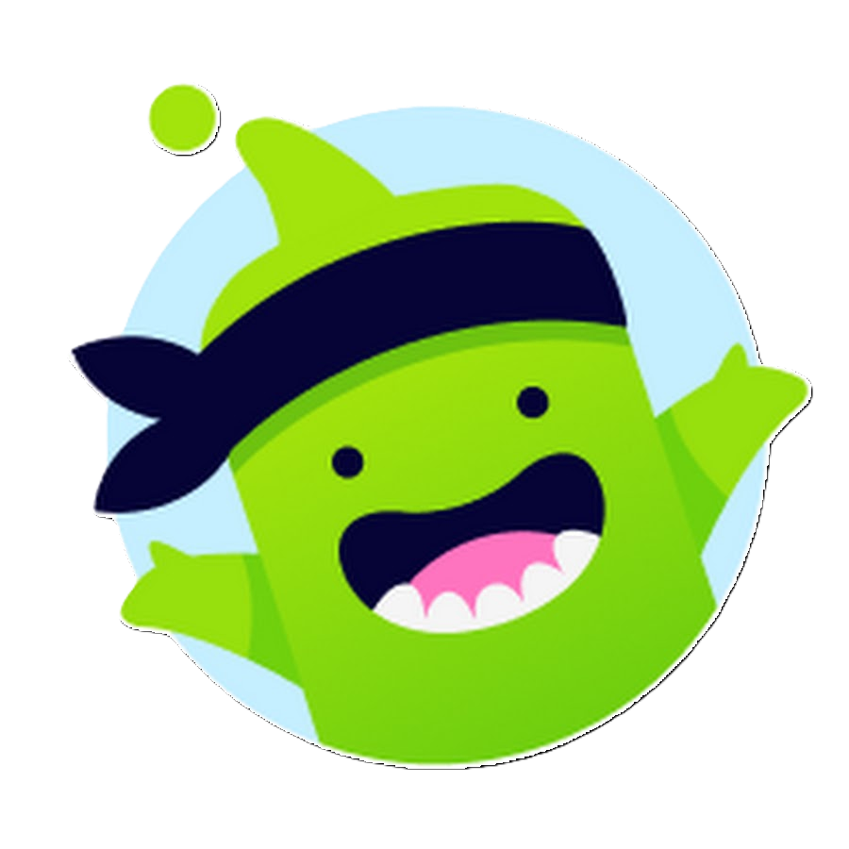

Present Day Solutions
Built-in accessibility
ADHD-aware browsers & timers
Specialized
Apps
Gamified
motivation
Classroom
Fundamentals
Notes:
Microsoft’s Immersive Reader voices text, widens spacing and adds on-screen grammar color-coding, helping ADHD learners decode and focus.
Edge’s “Split-Screen” + Read Aloud trim tab-hopping, while Pomodoro apps such as Focus To-Do scaffold short work bursts and planned breaks.
LearnyD offers bite-size, game-based English lessons with a built-in focus timer;
ClassDojo has point avatars and other game mechanics that deliver instant positive feedback;
Short, varied tasks, explicit praise and scheduled brain-breaks remain core recommendations for current teacher-training guides.

Slide 5

Introduction
Attenglish aims to enhance English learning experiences for students with ADHD. Our app focuses on engagement, adaptability and support, ensuring that every learner thrives in a fun and interactive environment tailored to their unique needs.
Notes:
So what is Attenglish?
It’s a mobile app for elementary to high school students with ADHD, built to engage, adapt, and support their unique learning styles.
It’s designed as a fun, interactive gamified environment that combines educational content with game mechanics, visuals, and audio—helping learners stay focused and motivated.
Our mission is simple: to give every student a fair chance to succeed in English.

Slide 6
Enhancing Student Engagement
Our app integrates interactive elements to capture student interest and motivate learning, fostering a dynamic educational environment that encourages participation.
Project Objectives Overview
Adaptive Instruction Methods
Attenglish tailors learning experiences to the unique needs of each student, accommodating diverse learning styles and pacing for effective skill acquisition.
Involving Teachers and Parents
Regular updates for parents on student progress
Teacher resources for personalized instruction
Opportunities for collaborative feedback and improvements
Notes:
Our project goals are:
To increase learner engagement through playful interaction, without the need for medications like Ritalin.
To enable adaptive instruction—so teachers can personalize content and repetition.
To foster better teacher-parent-student interactions, something that’s often missing.
And of course we want all progress to be measurable, because like it or not, it is still school.
Every feature in the app supports at least one of these objectives.

Slide 7





Key Actors
Attenglish serves four key actors,
each having specific permissions:
Teacher
Monitors progress and provide support
Student
Engages with tailored content
Parent
Tracks their child's development
Admin
Ensures smooth operation and management of the platform
Notes:
We designed Attenglish with four key actors in mind:
Students play, practice, and track their progress.
Teachers upload lessons and configure repetition schedules.
Parents can monitor progress and receive push notifications via SMS/Email.
And of course, admins who manage the entire system from back to front.

Slide 8





Functional and Non-Functional Requirements
Engagement
Adaptability
Parental Involvement
Measurable Outcomes
Security
Promote active learning and participation
Tailored experiences for diverse learners
Facilitating communication with parents
Assessing student progress effectively
Protecting user data and privacy
Attenglish adapts to individual learning styles and paces for enhanced understanding.
Regular assessments provide quantifiable results to track student improvements.
Attenglish ensures the highest security standards for user data protection.
The app encourages student engagement through interactive activities and feedback.
The app offers features that promote collaboration between parents and educators.
* The requirements were given by our stakeholder, Keren Yerushalmi, a middle-school English teacher.
Notes:
Our functional requirements reflect the daily needs of students and teachers:
Multi-modal lessons (text, audio, images).
A two-lesson cycle: one for teaching, one for practice with spaced repetition.
Support for interactive exercises like drag-and-drop and sentence building.
On the non-functional side, we had to:
Ensure the app runs smoothly on school-issued tablets.
Follow accessibility standards like dyslexia-friendly fonts and color schemes.
Provide secure logins using Ministry of Education credentials—no third-party sign-ins.
These weren’t optional—they were critical to meeting the real-world school environment.

Slide 9







Our Technology Stack
The Attenglish app utilizes cutting-edge technologies to
ensure optimal performance:
Cross-Platform
Development
Content & Analytics Generation
Database
Backend
Frontend
Flutter
Firebase
Node.js
React.js
OpenAI
Notes:
Let’s take a quick look at the technologies we’re using in our app.
We start with Flutter, which is very useful because it lets us build one codebase that works for both Android and iOS. That means faster development and fewer bugs across devices.
Next, we have Firebase. We're using it as our main backend and database. It helps us store user data in real time and handle authentication securely, which is important for working with kids.
For more advanced backend logic, we use Node.js. It runs behind the scenes and lets us build scalable services for things like notifications and lesson tracking.
On the frontend side of the teacher portal, we use React.js to create a fast and responsive web interface.
And finally, we use OpenAI tools to generate content and analyze student data. It helps us create smart, personalized feedback and activities based on each learner’s progress.

Slide 10
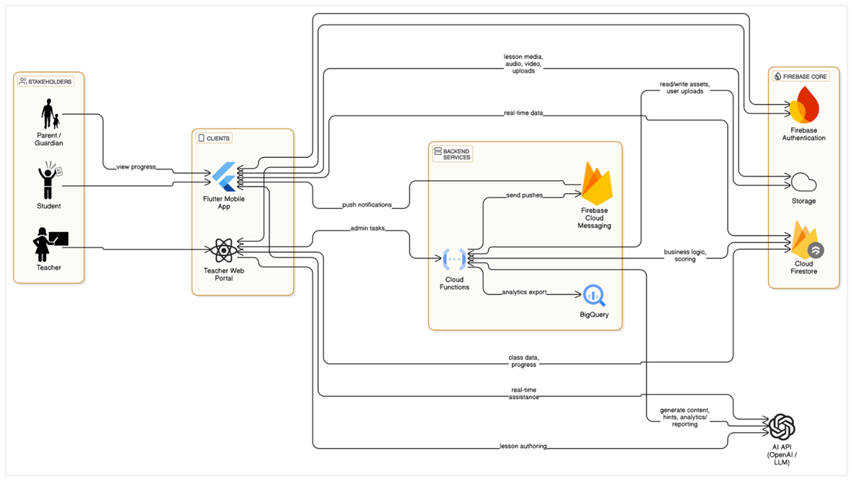
System Architecture Overview
The Attenglish architecture supports seamless communication between the client and backend. Our system includes three main components: the client app, backend services, and a robust database, ensuring efficient data handling and user experience.
Notes:
Here’s a look at our system architecture. It’s built to make sure everything works smoothly and securely, both for the pupils and for the teachers which all are our stakeholders.
We start with the Client App, which is what the pupils use. It’s built with Flutter and runs on their tablets or phones. This is where they see the lessons, do the exercises, and interact with the app.
Then we have the Teacher Portal, which is a web interface built with React. This is where teachers can upload lessons, track their pupils’ progress, and customize practice schedules.
Both the pupil app and the teacher portal send and receive data through our Backend Services, which we built using Node.js. These services handle things like saving lesson progress, sending push notifications, and connecting to AI features.
At the center of everything is our Firebase Database. It stores all the important data – like user profiles, lesson content manages push notifications, and progress logs – and syncs everything in real time. This way, when a pupil finishes a task, the teacher can see it right away.
And lastly, we have OpenAI Integration, which helps us with things like generating content, analyzing mistakes, and giving personalized suggestions to each pupil.
So this whole system is designed to be fast, secure, and adaptive – just like our users need it to be.

Slide 11
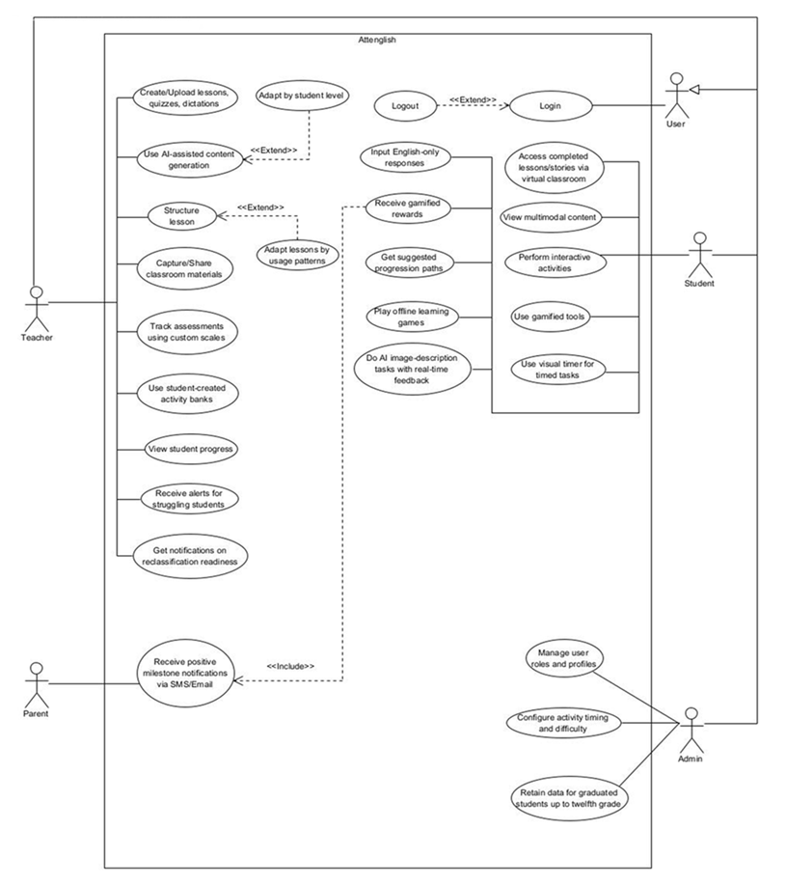

Use Case Diagram Overview
Notes:
Now let’s look at our use case diagram. This shows the different users in our system, and what actions each one can perform inside the app.
We’ll start with the Student – the pupil. Students can log in, and once they’re in, they can do a lot of things. They can:
Access completed lessons through the virtual classroom
View multimodal content like text, audio, and images
Perform interactive activities, like drag-and-drop or matching games
Use gamified tools to keep the learning fun
Set a visual timer to help with time-limited tasks
Do AI-based image description tasks with real-time feedback — for example, they might describe a picture in English and get suggestions instantly
Play offline learning games when there's no internet
Get suggested learning paths that adapt to how they’re doing
And of course, they receive gamified rewards to stay motivated — like points, badges, or stars.
Next is the Teacher. Teachers have many tools to support and customize the learning process. They can:
Create and upload lessons, quizzes, and dictations
Use AI to help generate content and structure lessons automatically
Adapt lessons based on how each student is learning or behaving in the app
Capture and share materials from the classroom directly into the system
Track students' assessments using custom scales
Use student-created activity banks to personalize tasks
View each student’s progress in real time
Get alerts when students are struggling — for example, if a student skips too many tasks or fails multiple quizzes
And get notifications when a student is ready to be reclassified — like when they might be ready to move to a higher level
Then we have the Parent. Parents don’t interact with the app directly, but they stay informed. They receive positive milestone notifications through SMS or email. For example, if a pupil finishes a unit or shows improvement, the parent gets a message. It keeps them involved and encouraged.
Last is the Admin. Admins help keep the system running smoothly. They can:
Manage user roles and profiles — like giving access to new teachers or resetting a pupil's password
Configure the timing and difficulty of activities — to match different class needs
And they also retain student data, even after graduation, up to twelfth grade — in case the data is needed for long-term reports or follow-ups
So as you can see, each type of user has specific roles that work together to create a supportive, adaptive learning environment for ADHD students.

Slide 12
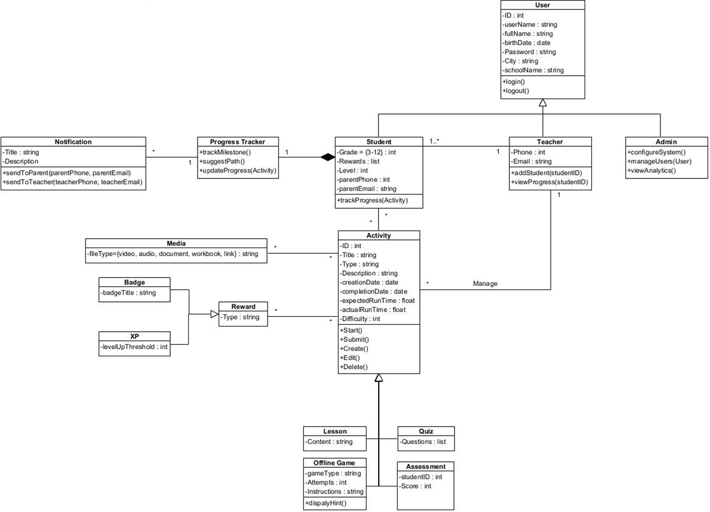

Class Diagram Overview
Notes:
Here’s a simplified view of the system’s class diagram. This diagram shows the main objects in our app and how they work together.
We start with the User class, which is the base class. Every user – student, teacher, or admin – is based on it and shares details like name, date of birth, school, and login info.
The Student class adds more details like grade, level, and contact info for the parent. Students can track their own progress and earn rewards for doing activities.
The Teacher class can manage students, add them to the system, and view their progress.
The Admin can configure the system, manage users, and view analytics — they help keep everything running behind the scenes.
The Activity class is one of the most important. It represents tasks like lessons, quizzes, and games. Each activity has a title, description, start and end time, and difficulty. Students can start, submit, or even redo them.
We also have a Progress Tracker, which helps follow what students are doing and suggest the next steps.
When a student does well, they get Rewards, like Badges or XP points, which keep them motivated.
Finally, there’s the Notification class, which sends messages to teachers or parents — like when a student hits a milestone.
So this whole diagram is like the blueprint of our app — it shows how users, content, progress, and feedback are all connected.

Slide 13

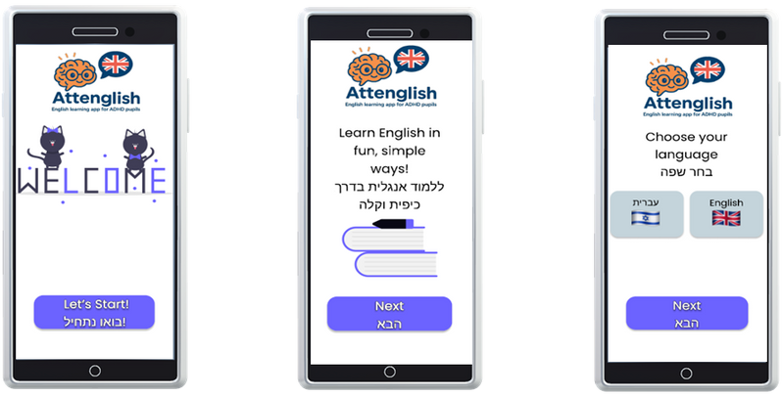
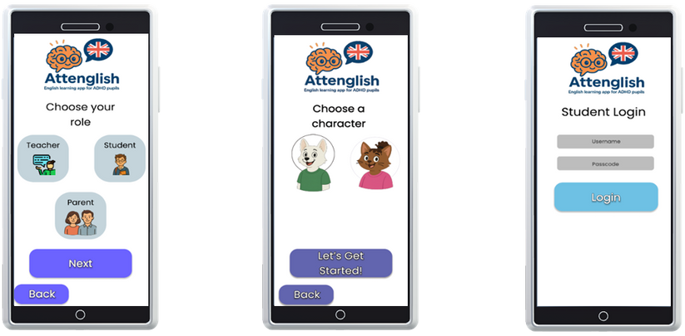
Front-End UI Concept
The Attenglish app interface is designed with ADHD learners in mind. Features include intuitive navigation, engaging visuals, and interactive elements to enhance focus and encourage active participation, promoting a playful learning experience tailored for young minds.
Notes:
This slide introduces the front-end UI concept of our app. The interface is intentionally designed with ADHD learners in mind. That means every part of the design—from the structure to the visuals—aims to support focus and engagement.
We emphasize three key features:
First, intuitive navigation, so users can move through the app smoothly without confusion.
Second, engaging visuals, which help capture attention and reduce distraction.
And third, interactive elements, which make the learning process more dynamic and hands-on.
Altogether, these features work to create a playful learning experience—one that is not only educational, but also enjoyable and tailored specifically for young learners with attention challenges.

Slide 14
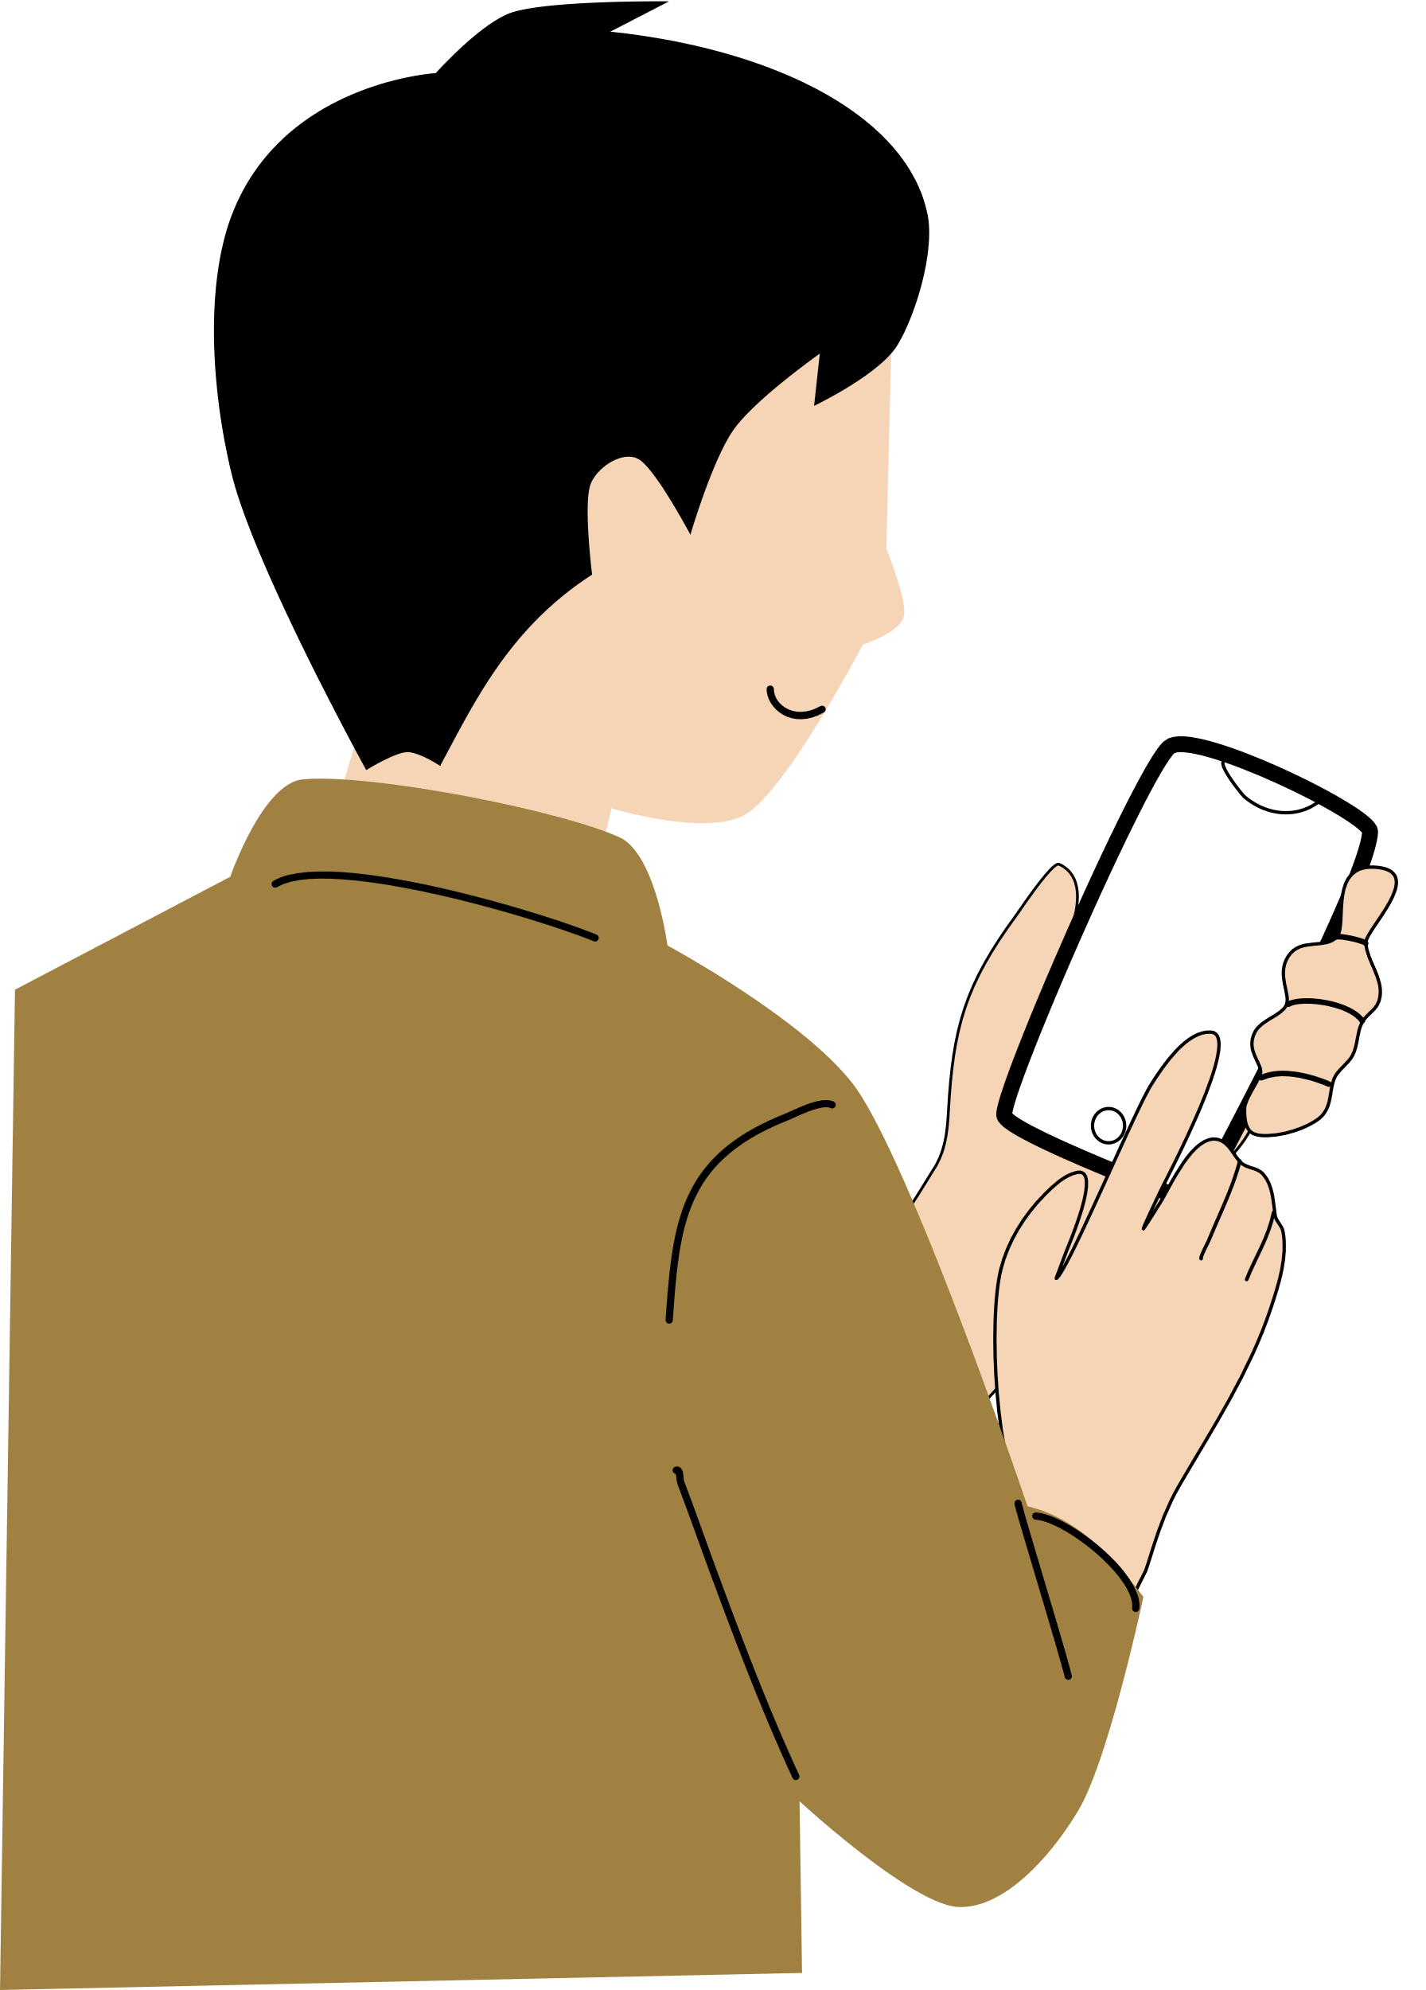



Challenges and Solutions
The development of Attenglish faces multiple constraints and challenges.
These include but not limited to:
User Constraints
All of our users vary in technical proficiency and device familiarity
Time Constraints
Our development window spans only a few months, making timely delivery of every milestone essential
Technical Constraints
Guaranteeing seamless operation across a range of devices and operating systems demands extensive compatibility testing and fine-tuning
Integrated Constraint Management
We address all our constraints through a coordinated strategy. This structured path - from discovery through specification, prototyping, and iterative validation - ensures that Attenglish addresses real educational pain points while meeting tight budgetary, security and timeline constraints
Notes:
In this slide, we talk about the main challenges we will face while developing Attenglish.
First, we have User Constraints. Our users — pupils, teachers, and parents — all have different levels of tech knowledge and use different devices, so the app must be extremely simple and easy to use.
Then we have Time Constraints. We only have a few months to build everything, so we must stay focused and make sure we deliver each part on time.
And of course, Technical Constraints. Since we want the app to work smoothly on many devices and systems, we must do a lot of testing and fine-tuning.
To deal with all these, we intend to use a clear, structured Agile approach — from planning, to building, to testing. This will help us stay on track and build a real solution for ADHD pupils, without losing time or quality.

Slide 15
Evaluation and Testing Milestones
Actor | Core Use-Cases to Validate | Desirable Test Outcomes | Primary Test Layer(s)
Student | • Login / Logout • Access completed lessons/stories (virtual classroom) • View multimodal content • Perform interactive activities • Use visual timer for timed tasks • Input English-only responses • Play offline learning games • Do AI image-description tasks with real-time feedback • Use gamified tools & receive rewards • Get suggested progression paths | 1. Path flow: Login → open classroom → start timed activity → complete with English-only input → receive reward → suggested next task appears. 2. Offline mode: start a cached “learning game”, finish, reconnect, verify progress sync. 3. AI vision: upload image, receive description hints in < 1 s; profanity filter blocks inappropriate content. | Flutter widget tests → Firebase Emulator E2E → Manual functional & UX
Teacher | • Login / Logout • Create / upload lessons, quizzes, dictations • Structure lesson (and extend “Adapt by student level / usage patterns”) • Capture / share classroom materials • Track assessments on custom scales • Use student-created activity banks • View student progress dashboards • Receive alerts for struggling students • Get notifications on reclassification readiness | 1. Authoring: drag-drop PDF → AI content generator suggests 10 quiz items → teacher edits, saves lesson; lesson visible to assigned class. 2. Adaptive tweak: flag student as “needs shorter timer”; verify lesson copy auto-inherits new timer. 3. Alerting: student fails 3 consecutive tasks → Cloud Function sends teacher push & portal badge. | React component tests → Cypress E2E → Manual functional
Parent / Guardian | • Receive positive milestone notifications via SMS / Email | 1. Pupil achieves 5-day streak → Twilio SMS sent; verify correct phone masked in logs. | Cloud-Functions unit tests → Postman mock-callback
Admin | • Manage user roles & profiles • Configure activity timing & difficulty • Retain data for graduated students up to 12th grade | 1. Bulk CSV import → 100 users created with correct roles. 2. Change default timer from 45 → 30 s; confirm new lesson picks. 3. Archive graduated class; verify records are still queryable (read-only) after 30 days. | Jest unit → Admin-portal Cypress → Data-retention integration tests
Notes:
Let’s go over the main test cases we will run for each type of user.
For Students:
We test the full path — login, start an activity, complete it while using English-only input, get a reward, and move to the next task.
We check that offline learning games work even when disconnected, and that progress syncs when the internet comes back.
We test our AI vision feature — it generates a picture, gives a hint in less than 1 second, and blocks inappropriate content. The student explains what they see in the picture.
For Teachers:
We test uploading a PDF, check if the AI creates quiz items, and verify that the teacher can edit and publish them to the class.
We flag a student as needing extra support and check if the lesson automatically updates with a shorter timer.
If a student fails 3 times, we check that the teacher gets a push notification and a badge in the portal.
For Parents: We test that after a student uses the app for 5 days in a row, a message is sent to the parent’s phone, and the phone number stays hidden in the logs.
For Admins:
We import 100 users and check that all roles are correct.
We change the default timer from 45 to 30 seconds and make sure it appears in new lessons.
We archive data for graduated students and confirm it remains viewable but locked after 30 days.
All these tests help us make sure the app is stable, smart, and safe for everyone.

Slide 16
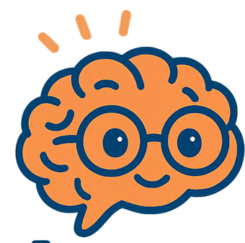


Thank you!
Any questions?

